Slide 1
Maze Solving Robot
Zak Oster

Slide 2
Project

Slide 3
Raspberry Pi Pico W

Slide 4
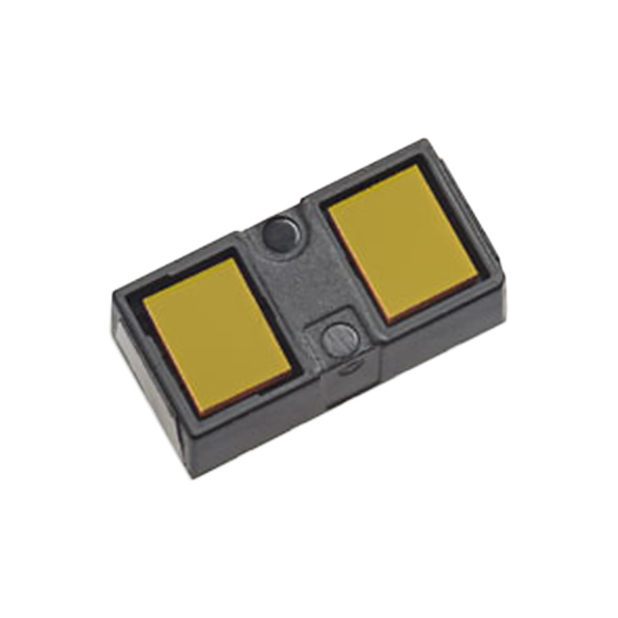
VL53L1X
I2C optical sensor
STM Datasheet

Slide 5
VL53L1X Driver
Driver based on STM source files

Slide 6
HC-SR04

Slide 7
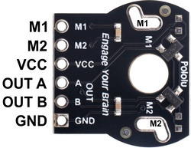
Romi Encoder Pair Kit
Uses a dual-channel Hall effect sensor and a 6-pole magnetic disc
Quadrature encoding
https://www.pololu.com/product/3542

